Slide 1
CSE 2102: Introduction to Software Engineering
Software Design

Slide 2
The IS_COMPONENT_OF relation
Used to describe a higher level module as constituted by a number of lower level modules
M_{i} IS_COMPONENT_OF M_{j}
  M_{j} consists of several modules, of which one is M_{i}
M_{j} COMPRISES M_{i}
M_{S,i}={M_{k}|M_{k}∈S∧M_{k} IS_COMPONENT_OF M_{i}} we say that M_{S,i} IMPLEMENTS M_{i}

Slide 3
The IS_COMPONENT_OF relation (contd..)
A Graphical View
M
M
M
M
M
M
7
8
9
5
6
1
M
M
3
M
4
2
M
M
M
4
2
3
M
M
M
M
M
M
1
7
8
9
5
6
(IS_COMPONENT_OF)
(COMPRISES)
IS_COMPONENT_OF relation constitutes a hierarchy

Slide 4
Conceptual view of a module
“Services needed” IMPORTED – What does a module need externally?
“Services provided” EXPORTED – What parts of the module others can
use?
“CODE” - Implementation of functions
END

Slide 5
Example of a module
MODULE CASH_REG
{
SCANNER
KEYPAD
DISPLAY
DB of Prices
LINKS to ATMs, CCs etc.
IMPLEMENTATION
}
S
Inside module
K
D
Outside module
“Imported”
IImportt
Impl

Slide 6
Pictorial view of modules
MODULE table
MODULE buffer
procedure insert;
procedure find;
const limit;
var tab, avail;
……
procedure bodies
initialization
Public interface
procedure enter;
procedure leave;
const nul;
const maxbuf;
var size, front…
procedure succ;
….
procedure bodies
….
initialization
Private impl.

Slide 7
Modules: Interface vs. implementation
Interface:
  Public portion, or the portion accessible outside the module.
  Provides information about what services the module offers.
  Hides how those services are implemented.
  Clients only need to see the interface to use the module.
  Module is said to “export” the services.
  Client, or the user of the module “imports” the services.
  Acts as a contract between the module and its clients.
Implementation:
  Private portion, or the portion accessible inside the module.
  “How” the exported service is implemented.
  Implementation is hidden from the clients, may be composed of other modules of actual code.
Separation of concerns is supported by division between a module’s interface and implementation

Slide 8
Modules: Interface vs. Implementation
To understand the nature of USES, we need to know what a used module exports through its interface
  The client imports the resources that are exported by its servers
  Modules implement the exported resources
Implementation is hidden to clients

Slide 9
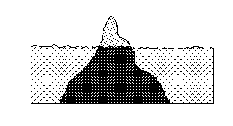
Modules: Interface vs. Implementation (contd..)

Slide 10
Modules: Interface vs. Implementation (contd..)
What goes in the public interface?
What goes in the hidden implementation?
Interface design considerations:
  Interface must convey to the client the services that it provides
  Too much information in the interface increases overall system complexity
  Internal knowledge in the interface may cause change in the implementation to affect interface
  Not enough information in the interface, module may not provide required services
Interface design depends on the needed services provided and the information the clients will not use
Identification of likely changes is necessary, since that goes in the implementation.

Slide 11
Modules: Interface vs. Implementation (contd..)
Clear distinction of interface and implementation supports prototyping.
  In prototyping, an initial version may represent a “quick and dirty” implementation of the service provided by the module.
As long the interface remains the same, this initial “quick and dirty” version may be replaced by a more efficient one, without affecting the clients of the modules.
Easy to evolve the initial prototype into a final product.

Slide 12
Modules: Interface vs. Implementation (contd..)
Module supports information hiding by making a clear distinction between the interface and the implementation.
Information hiding is a global design principle.
It states that:
  Encapsulate changeable design decisions as implementation secrets within module implementations.
Clients or users of modules are not exposed to the implementation secrets
  Secrets can be changed freely without affecting the clients and the system structure.
Basis for decomposing a system into modules.

Slide 13
Modules: Interface vs. Implementation (contd..)
Policies are used to implement high-level design decisions
  They should be hidden in the implementation.
Separation of policy vs. mechanism
Policies may be separated from mechanism:
Mechanism:
  Ability to suspend and resume tasks in a concurrent system
Policy
  How do we select the next task to resume?
    Different scheduling policies are available
    They may be hidden to the clients
    They may be encapsulated as module secrets

Slide 14
Advantages of modular designs
Reduces complexity, by providing a systematic means of breaking problems into sub-problems.
Facilitates change – critical aspect of software maintainability.
Results is faster implementation by encouraging parallel developments of different parts of a system.
Supports reuse of existing modules in new systems.

Slide 15
Properties of modular designs
Each module should be functionally independent:
  Addresses a specific sub-function of requirements and has a simple interface when viewed from the other parts of the system structure
Independence is measured using two criteria:
  Cohesion - Indication of the degree to which a module focuses on just one thing
  Coupling - Indication of the degree to which a module is connected to other modules and to the outside world
Good design has high cohesion and low coupling

Slide 16
Top-down design strategy
Large modules are decomposed into smaller modules which are said to implement the large modules
General Specific

Slide 17
Bottom-up design strategy
Pieces
Compose

Slide 18
Top-down vs. bottom-up design strategy
Information hiding proceeds “bottom-up”
Iterated application of IS_COMPOSED_OF relation to modules proceeds “top-down”
Bottom-up strategy:
  Lowest level modules are combined to form larger modules
Top-down vs. bottom-up:
  In practice, a combination of both the approaches is followed. This is known as the “yo-yo” design is followed.
No matter what the design process followed is, the documentation should always be organized in a top-down manner.

Slide 19
Design notation
English language is too ambiguous to fully describe software designs
No standardized notation for software currently in use.
Two types of notations:
  TDN – Textual design notation
    Resembles a programming language
  GDN – Graphical design notation

Slide 20
Graphical design notation (GDN)
In general, graphical notations are easier to read and understand.
A module is represented graphically as a box
Incoming arrows represent interface
- Represent access to the module
Module
X
Module
Y
Module
Module
R
T
B
C
Module
Z
A
B

Slide 21
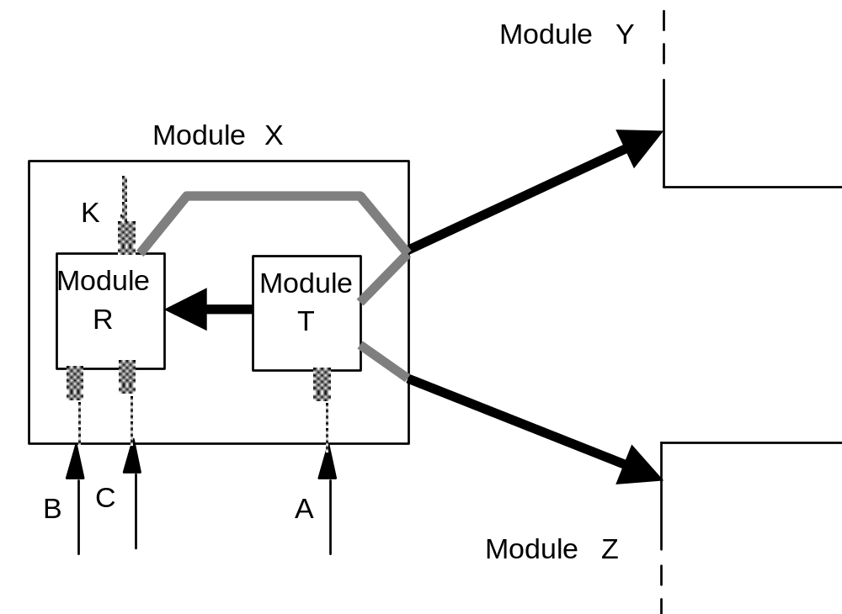
Graphical Design Notation (contd..)
X's decomposition

Slide 22
Graphical Design Notation (contd..)
Resources exported by module X:
  B and C are exported by module R, A is exported by module T.
Modules used by module X:
  Module R uses module Y.
  Module T uses module Y
  Module T uses module Z

Slide 23
Graphical Design Notation (contd..)
Notation helps describe a design precisely
Design can be assessed for consistency
  having defined module X, modules R and T must be defined eventually
    if not → incompleteness
  R, T replace X
    → either one or both must use Y, Z

Slide 24
Handling anomalies
Defensive design
  Try to shield an application from errors
A module is anomalous if it fails to provide the service as expected and as specified in its interface
Defensive design requires an exception to be raised when anomalous state is recognized

Slide 25
Handling anomalies (contd..)
A module M should fail and raise an exception if
  one of its clients does not satisfy the required protocol for invoking one of M’s services
  M does not satisfy the required protocol when using one of its servers, and the server fails
  hardware generated exception (e.g., division by zero)

Slide 26
Handling anomalies (contd..)
Before failing, modules may try to recover from the anomaly by executing some exception handler (EH).
Exception Handler (EH) is a piece of code that may:
  Try to recover from anomaly (if successful, module does not fail)
  Or simply do some cleanup of the module’s state and then let the module fail, signaling an exception to its client.

